Slide 1

TrustChain: Building Trust Through Transparent Supply Chains
A blockchain-empowered digital framework for India's MSME sector.
Joel Sundarsingh A, B Kailaash | Rajalakshmi Engineering College

Slide 2

I. INTRODUCTION
The MSME Trust Deficit
The Challenge
The Impact
India's MSME supply chains face fragmented communication, delayed settlements, and a critical lack of transparency in transactional commitments.
These deficiencies lead to financial disputes, operational inefficiencies, and inconsistent collaboration across vendor networks.
The Solution
TrustChain introduces a unified, blockchain-empowered framework to foster transparency, traceability, and trust.

Slide 3

TrustChain Objectives and Scope
Transparency & Traceability
Secure Payments
Adaptive Trust
Record every activity in an immutable blockchain ledger for tamper-proof auditability and non-repudiation.
Integrate escrow-secured payment mechanisms and automated verification for accountable financial interactions.
Implement a dynamic TrustScore model, supported by ML, to continuously evaluate user credibility based on behavior.
TrustChain consolidates transparency, payment security, and trust analytics into a single decentralized platform.

Slide 4
III. METHODOLOGY
Modular, Containerized Architecture
The TrustChain system uses a multi-layered, containerized architecture, integrating distinct, interdependent modules for scalability and secure management.
Web/Mobile Layer
Backend Layer
User interaction interface with dedicated dashboards.
Core operational engine: handles authentication, transaction management, and trust-score computation.
Blockchain Layer
Database Layer
Ensures trust and transparency via smart contracts for decentralized recordkeeping.
Stores off-chain data (MongoDB) and manages certification records (Data Layer).
The system is deployed within Docker containers, simplifying maintenance and scaling.

Slide 5
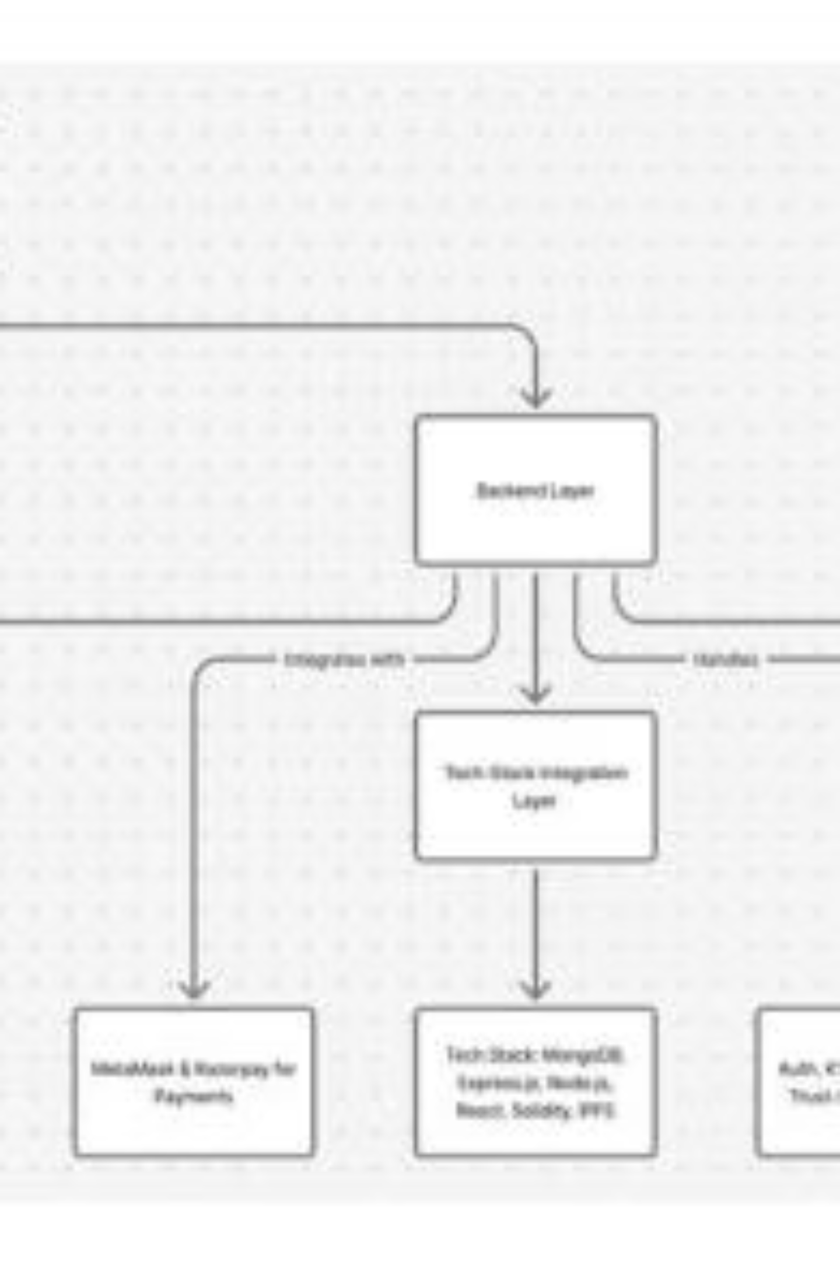
TrustChain System Architecture
Figure 3.1. Architecture Diagram of the system, structured into five primary layers.

Slide 6

Core Functional Modules
User & Transaction Flow
Escrow Payment & Verification
Manages authentication, order placement, and links orders to blockchain transaction IDs for traceability.
Secures payments using blockchain-anchored smart contracts, releasing funds only upon verified delivery.
TrustScore Evaluation
ML & Recommendation Layer
Dynamically computes participant credibility based on timely delivery, payment punctuality, and dispute frequency.
Analyzes data to generate predictive insights on vendor reliability and risk detection, updating TrustScores.

Slide 7

IV. RESULTS AND DISCUSSION
User Dashboard and Transaction Visibility
User Dashboard Overview
The dashboard consolidates essential metrics: active pledges, escrow transactions, and real-time TrustScores. This unified view ensures all stakeholders share a synchronized understanding of operational status, eliminating fragmentation.
Users register and initiate payments via a secure, integrated process, ensuring cryptographically verifiable transactions.
Figure 3.4. User Dashboard Overview

Slide 8
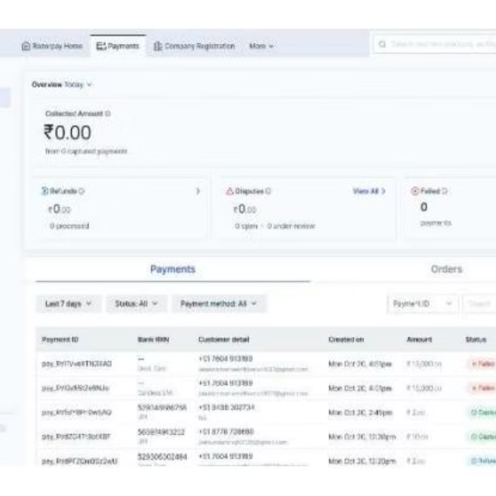
Escrow Security and ML-Driven Recommendations
Escrow Payment Status
Visual validation confirms funds are secured until successful delivery verification, reducing financial disputes.

Slide 9

V. CONCLUSION & REFERENCES
TrustChain: A Foundation for Trustworthy MSME Supply Chains
TrustChain successfully integrates blockchain immutability, smart contract automation, and intelligent analytics to enhance accountability, reduce disputes, and foster measurable trust growth across MSME supply chain participants.
Key References
[1] R. Kumar and A. Singh, Supply Chain Transparency for MSMEs through Digital Platforms, 2022.
[4] Y. Zhang and L. Chen, "Trust Management Framework for Supply Chain Networks," 2020.
[6] M. Gupta, S. Rao, and K. Jain, "Escrow Systems for Secure Supply Chain Transactions," 2022.
[13] S. Dutta and P. Roy, "Blockchain Verification in Supply Chain Commitments," 2023.

